Slide 1
Teradata Bacis
Lesson 03 : Teradata Utilities (Bteq)

Slide 2
Module Object
Introduction about Teradata
Introduction to BTEQ.
Use of BTEQ
Transaction Mode in BTEQ
Conditional Logic in BTEQ
BTEQ Return Codes
Using BTEQ to Export Data
Using BTEQ to Import Data
BTEQ Commands
Presentation Title | Date
Copyright © Capgemini 2015. All Rights Reserved 2

Slide 3
Introduction about Teradata Utility
What is the need of Teradata utilities in Data ware house
Quick access to data for more timely decision making.
Solutions for the entire spectrum of load requirements from batch to near real time.
Unmatched scalability for large volume loads.
Fail-proof loads with checkpoint restart capabilities.
Proven technology from the data warehouse technology leader.
Integration with industry-leading ETL and ELT tools.
Teradata Utilities
BTEQ: Help for Report formatting, Ad hoc query tool, Database administration, Best for small data volumes.
Fast Export :High-performance data unload in client format.
Fast Load: High-performance initial table load.
Multi Load: High-performance maintenance operations applies updates to multiple tables in single pass.
Apart from these teradata having other utilities like Teradata Parallel
Transporter,Tpump e.t.c.

Slide 4
Introduction to BTEQ
The core and main utility of Teradata is BTEQ , which stands for Batch/Basic Teradata
Query. This is a command –based utility submitting SQL requests to the Teradata database.
Characteristics:
BTEQ (Basic Teradata Query) operates in either a Batch or Interactive mode.
BTEQ runs on every supported platform.
BTEQ has the ability for Exporting data from database and importing data to database.
BTEQ has flexible and easy-to-use report writer.
Reads input data and imports it to the Teradata database as INSERTs, UPDATEs or DELETEs.
Exports data to a client system from the Teradata database:
As displayable characters suitable for reports, or
In native host format, suitable for other applications.
BTEQ does error reporting.
Presentation Title | Date

Slide 5
Supporting Environment
The Fast Export utility is supported either on either the mainframe
Or on network attached system(LAN.
The LAN environment supports the following Operating Systems:
UNIX MP-RAS
Windows 2000
Windows 95
Windows NT
UNIX HP-UX
AIX
Solaris SPARC
Solaris Intel

Slide 6
Supporting Environment
The Mainframe (Channel Attached) environment supports the following Operating Systems:
MVS
VM
CAUTION: The Teradata RDBMS will only support a maximum of 15 simultaneous
FastLoad, MultiLoad, or FastExport utility jobs

Slide 7
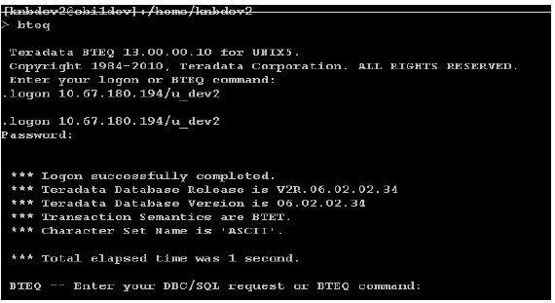
Use of Bteq
Bteq can be used either batch or interactive environment.
Interactive Mode:
Interactive users can submit SQL and receive an answer set on the screen.
Steps to follow:
Use the word bteq.
Logon by giving the host id/user id.
Give the correct password for this user.
After connect the session use the required query to get the result.

Slide 8
Use of Bteq
Batch Mode:
Users can submit BTEQ jobs from batch scripts, have error checking and conditional logic, and allow
for the work to be done in the background.
To submit a job in Batch mode do the following:
Invoke BTEQ
Type in the input file name
Type in the location and output file name.

Slide 9
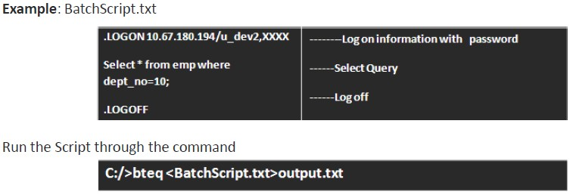
Use of Bteq

Slide 10
Transaction Mode
Teradata works in two modes:
Teradata Mode
ANSI Mode
While using BTEQ, it is possible to over-ride the transaction mode at the session level. Since the session is established at logon time, it is necessary to set the mode prior to issuing a logon connection request. In BTEQ, either of the following commands can be used to change to ANSI or Teradata (BT-ET) mode:
SET SESSION TRANSACTION BTET;
Or
.SET SESSION TRANSACTION ANSI;

Slide 11
Transaction Mode
BT-ET Mode: Use a BT-ET statement to Begin Transaction (BT) and End Transaction (ET). Like
BT;
// SQL statements;
//SQL statements;
ET;
When multiple statements are placed into a single transaction in Teradata Mode (BT-ET
mode) an error with any statement causes all of the SQL statements to ROLLBACK and then all locks are released and it is committed automatically if the entire transaction is successful. This means all the SQL statement placed in the BT-ET block are treated as a single statement.
It is also called the explicit transaction mode. When multiple statements are included in
BT-ET mode, you can only specify a DDL statement if it is the last statement.

Slide 12
Transaction Mode
Multi-Statement Request:
Another way to achieve the Teradata mode is Multi-Statement Request. Multi-statement request is created in BTEQ by placing ending semi-colons as the first character of next SQL statement and makes the statement list as one transaction. Here is an example of a BTEQ transaction in Teradata Mode that is considered one transaction:
UPDATE Employee_Table
SET Salary = Salary * 1.1
SET Dept_Name = ‘Sales’
WHERE Dept_No = 10;
In multi-statement request, if a transaction has any SQL fail then all SQL statements are rolled back and locks are released. DDL statements are not valid in an implicit multi-statement transaction.

Slide 13
Transaction Mode
ANSI Mode:
In ANSI mode, just the opposite is true. All SQL commands are considered to be part of the same logical transaction. A transaction is not complete until an explicit COMMIT is executed. Therefore, each of the DML commands in ANSI mode needs to perform the following command to permanently store the data, and more importantly, release the write locks that are currently held.
COMMIT WORK:
As an example, to remove all rows both statements below can be needed in ANSI mode.
DELETE FROM TEST_TABLE;
COMMIT WORK;
Without a COMMIT WORK, it is likely that the DELETE will abort and all the rows will be
put back.

Slide 14
Conditional Logic in BTEQ
Create a duplicate table same as ernp table:
1-LABLE Tbl_fail
Delete the records from the duplicate table dup_emp, if it has,
If the result is non zero then create the duplicate table, else attempt to insert the records from parent table emp.
If getting non zero result in insert activity then go to the next instruction,

Slide 15
BTEQ Return Codes
Bteq Returns two-digit values to the user after completing each job or task
The value of the return code indicates the completion status of the job or task as follows.
Return Code Description;
00 Job completed with no errors.
02 User alert to log on to the Teradata DBS.
04 Warning error.
08 User error.
12 Severe internal error.
You can over-ride the standard error codes at the time you terminate BTEQ. This might be handy for debug purposes. The error code or "return code" can be any number you specify using one of the following
Override Code Description;
.QUIT 15
.EXIT 15

Slide 16
Using BTEQ to Export Data
IBTEQ alHows. data tu be exported directlv from Teradata tu a fHe on a mainframe or network-attached computer,with desired output.
Generallv , user exported data in with different export format, composed of vari1ety of characteristics,
F'onm1at of Export command :
.. EXPORT <mode> {FIILE [I DDNAME} =<filename>[, UMIT=n
Exa1mpllle :
Bteq script: exportl.btq

Slide 17
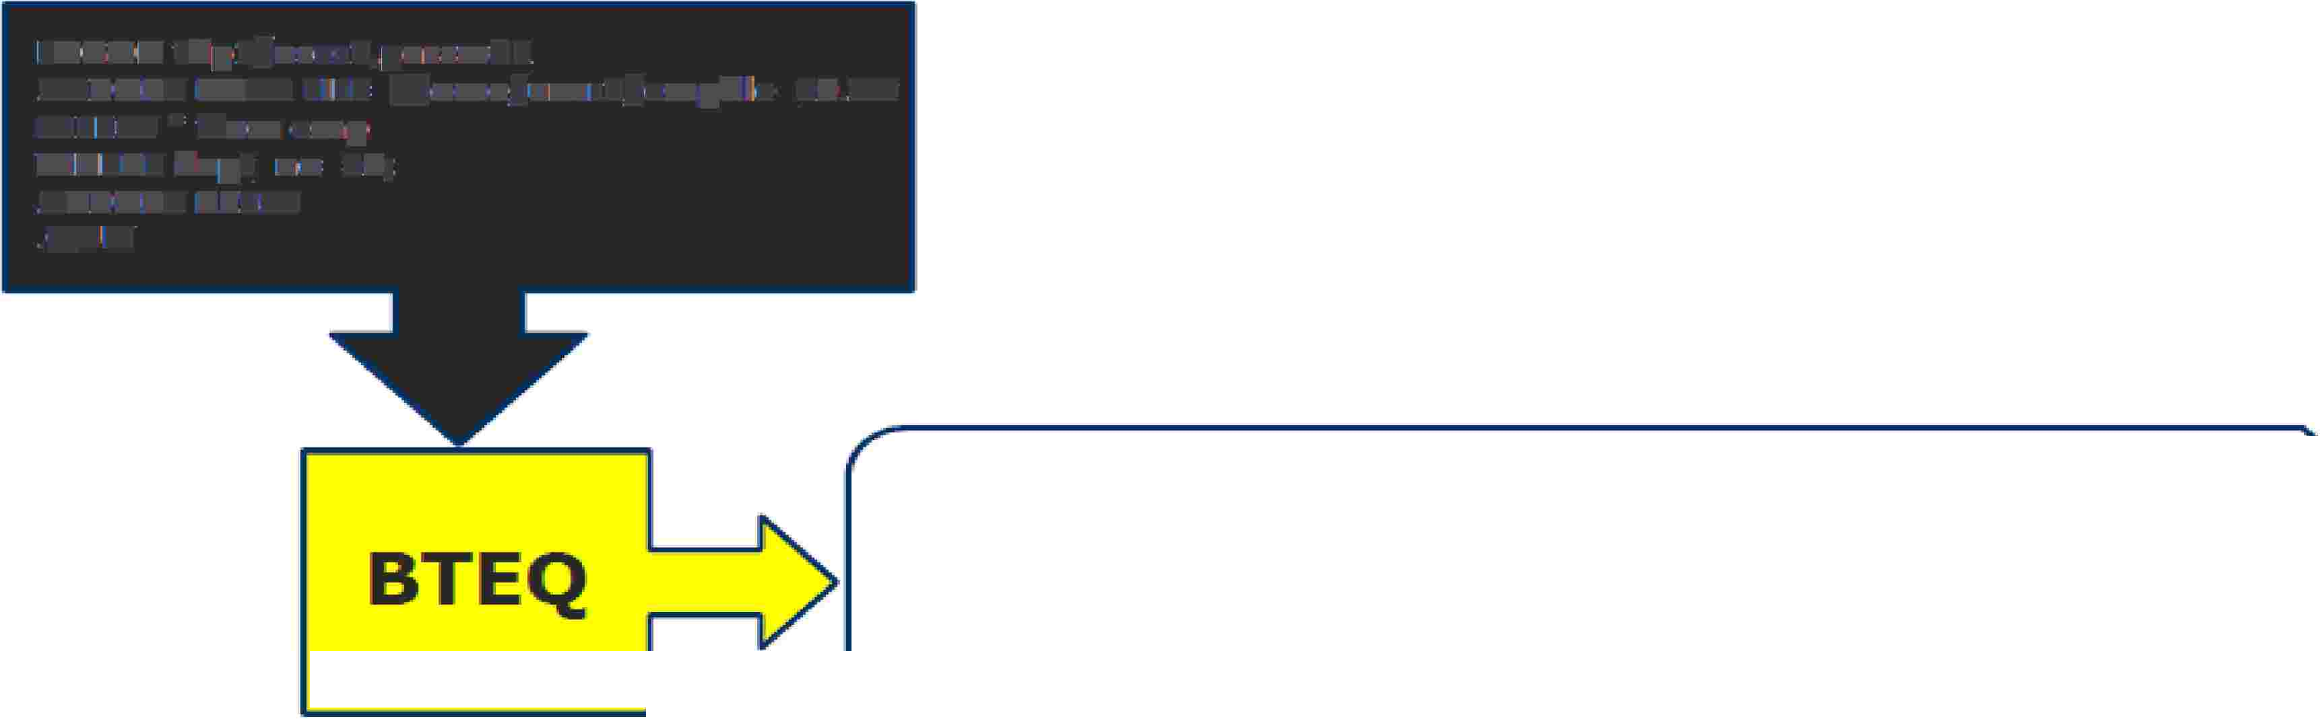



Using BTEQ to Export Data
LOGON tdp1/us-er1,passwd1
.EXIPORT DATA flLE=/home/user1/empfile_10.txt
SElE¹CT * from ernp
WHERE dept_no=:10;
.EXIPORT RIESET
.QlllT
7782,,ClARK.,MANAGER,, 7839 .. 19¹81-06-09,245'0.0Qi.,? ,10
7839, Kl NG"' PRES I DlE N"t?, 1981-·1·1-17, 5¹000.00,?, 10
BTEQ
7'9.34.,M I LLER.,CLE RK"' 7782,
.,1982-01-2,3·"' 1300 .. iOO"'? .,·10
bte q < expo rtl .. btq>empfille_lO ..itxt
O utp1ut: e mpfi I e_·10 .. tx:t

Slide 18

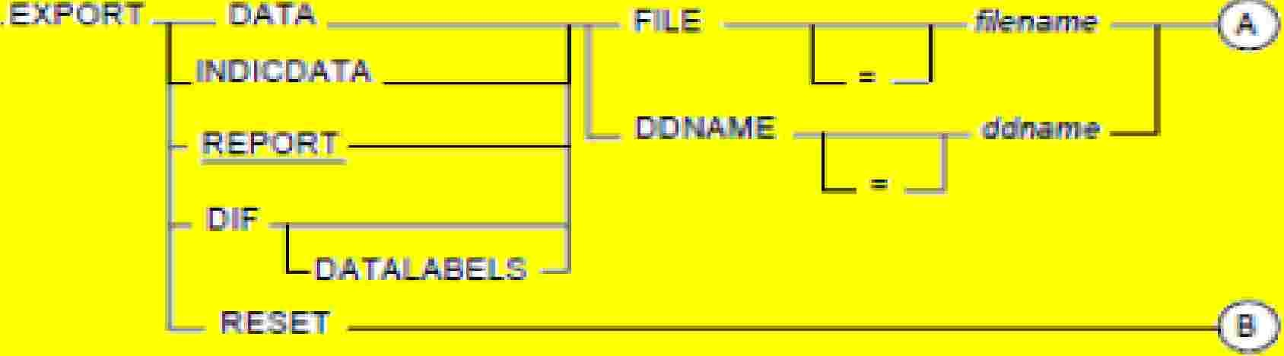
Using BTEQ to Export Data
Record Mode (also called DATA mode): This is set by. EXPORT DATA. This w111II bring data back. as a flat file. There are no headers or white space between the data contained in each column and the data ls written to the file in native format, not understood using text editor.
Field Mode (ialso called REPORT mode): This is set lby .EXPORT REPORT This is the default mode for BTEQ and brings the data back as if it was a standard SQL SELECT statement, output of this BTEQ export would return the column headers for the fields, and better understood m text editor.

Slide 19
Using BTEQ to Export Data
Indicator Mode:
This is set by .EXPORT INDICDATA. This mode writes the data in data mode, but also provides host operating systems with the means of recognizing missing or unknown data (NULL) fields. This is important if the data is to be loaded into another Relational Database System (RDBMS).
DIF Mode:
Known as Data Interchange Format, which allows users to export data from Teradata to be directly utilized for spreadsheet applications like Excel, FoxPro and Lotus.
In Mainframe export the data into the file by define command
.EXPORT DATA DDNAME = data definition state name (JCL)
In LAN export the data into the file by define command like :
.EXPORT DATA FILE = actual file name

Slide 20
Using BTEQ to Import Data
BTEQ can also read a file from the hard disk and incorporate the data into SQl to modify the contents of one 01r moire tables. In order to do this processing, the name and record description of the file must be known ahead of time. These wrn be defined within the script file.
f'onmat of the MPORT command:
.IMPORT {FILE DNA.ME}=< fHename>[. SIKIP=n]

Slide 21
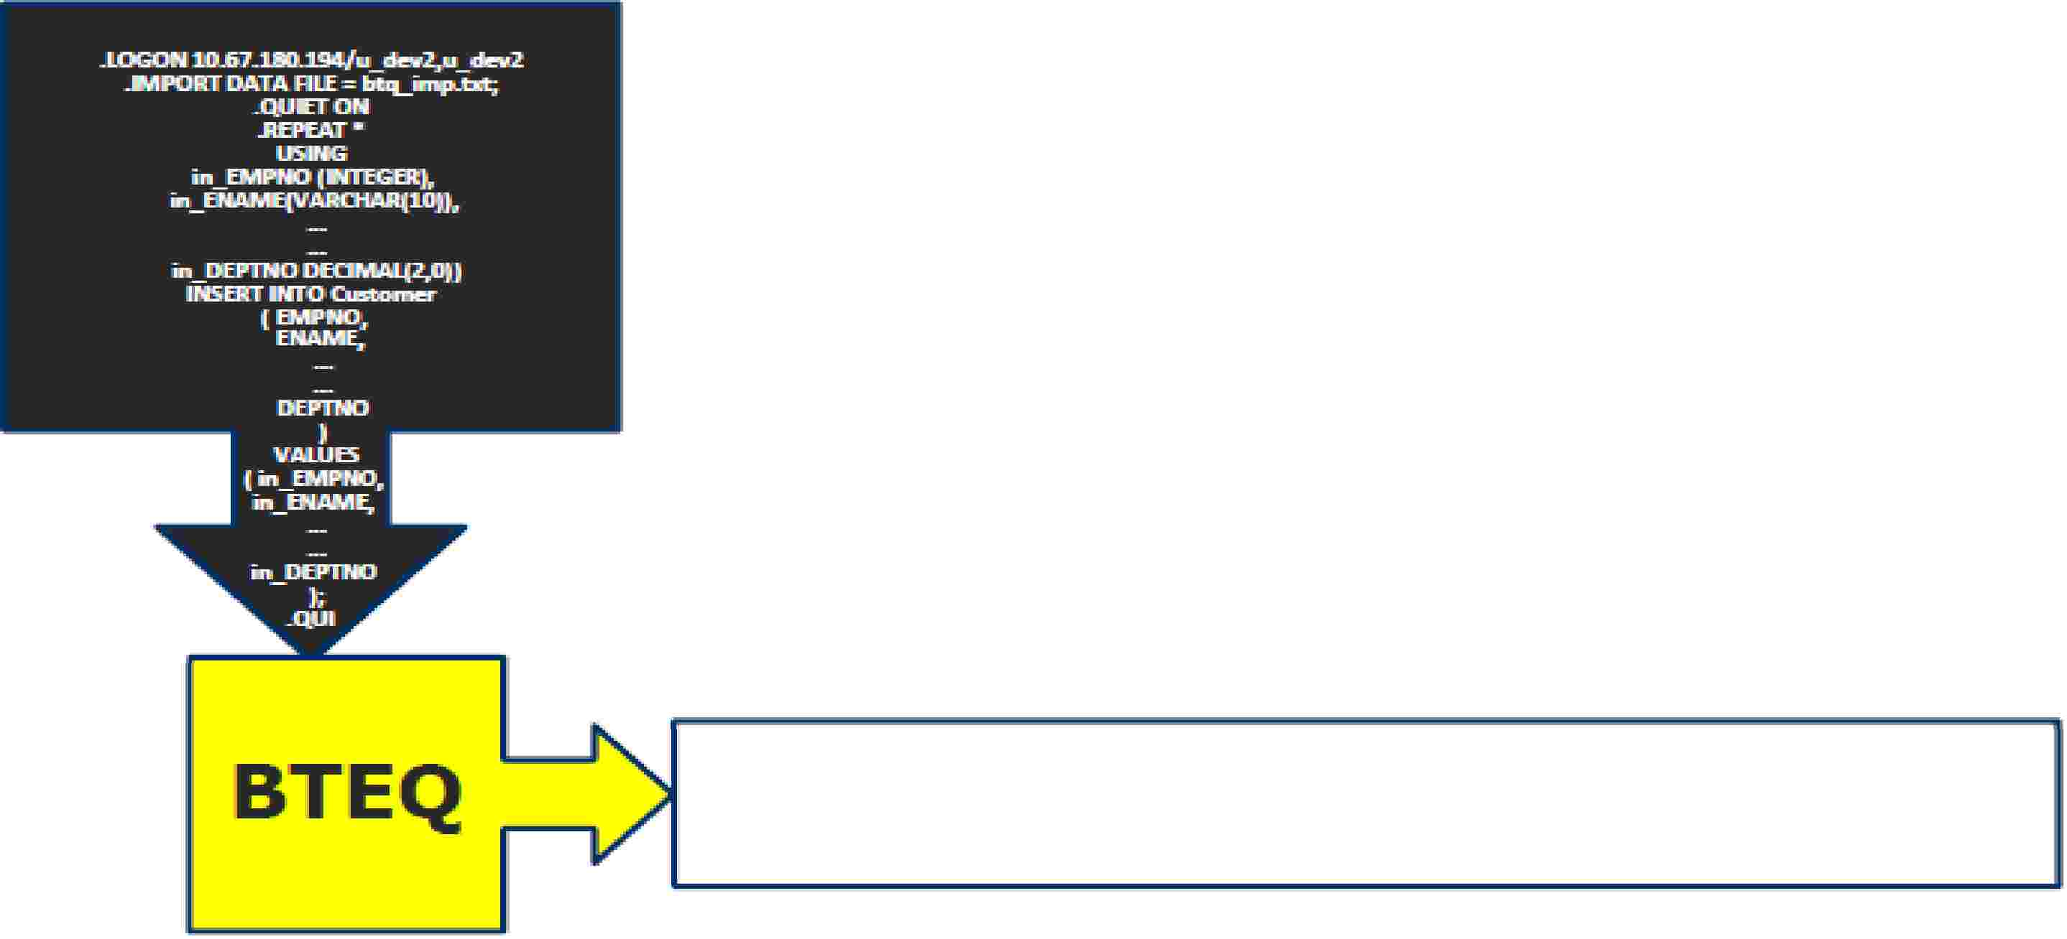
Using BTEQ to Import Data

Slide 22
Using BTEQ to Import Data
BTEQ can also read a fi le from the ha rd d isk and incorporate the data mto SQ .to modify the contents of one

Slide 23
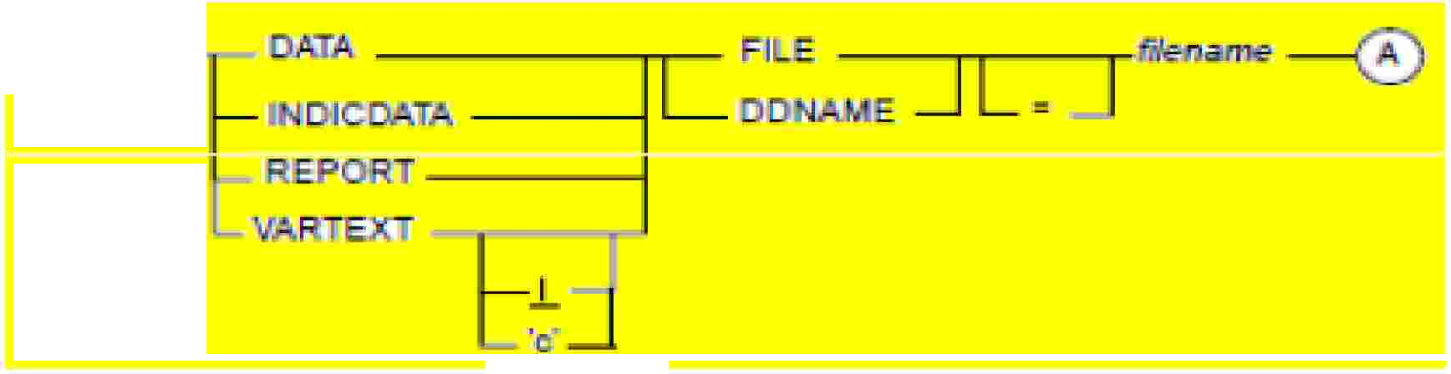




Using BTEQ to Import Data
BTEQ can also read a fi le from the ha rd d isk and incorporate the data mto SQ.to modify the contents of one or more tables, In order to do this processing, the name and record description of the file must be known ahead of tune, These will be defined within the script file.
For Network-Attac ed Systems.:
flormat of the MP'ORT command:
.IMPORT { FILE I D A.ME}= <filename>(,SIKIP=n]
For Channel-Attached .Sys.terns:
.IM
I
TI
IL
I
A. )'-------.----------.------------1...I

Slide 24
Using BTEQ to Import Data
Data :- Imports data from the server to Teradata with a USING clause.
INDICDATA :- Import records contain NULL bits.
REPORT :- Imports Teradata “report”data. Data expected in BTEQ EXPORTREPORT format.
VARTEXT :- Record format as variable length character fields. Default delimiter is | or specify with field delimiter within single quotes.

Slide 25
BTEQ Commands
The BTEQ commands i1n Teradata are designed for flexibllltv These commands are not used direcUy on the data
inside the tables. However, these 60 ditferent HTEQ commands are utilized in four areas.
)io'"Session Control Commands:
begin and end BTEQ sessions, and control session characteristics.
�File Control Commands:
Spedfy input and output formats and identify information sources and destinations,
)io'"Sequence Control Commands:
control the sequence in which other BTEQ commands and Teradata SQL statements willll lbe executed within scripts and ma cros.
�Format Control Commands:
control the format of screen a nd printer output.

Slide 26
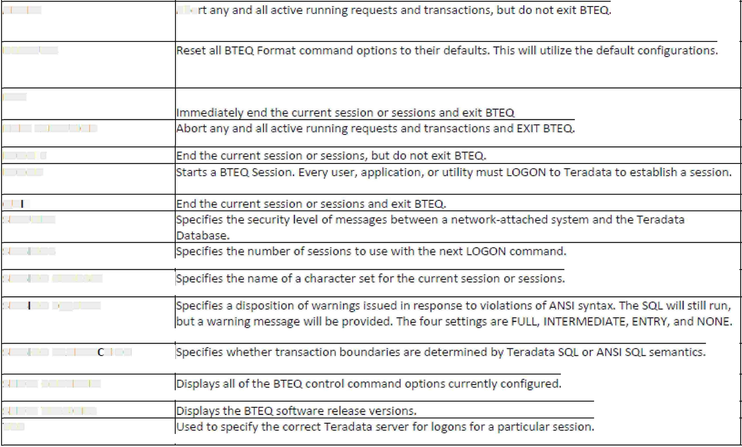
BTEQ Commands
Session Centro Command
ABORT
Abo
DEFAULTS
EXJJ
HALT EX ECUllilON
LOGO Ff
LOGON
QUIT
SEUIRIT\f
SESSIIONS,
he next
OGO N comm d.
S ESSIION CHARSH
SESSION SQLIIFLA'6
S ESSIION TRANSA ·. lilON
SHOW GONliROLS
SHOW VERSIONS
liDP'

Slide 27
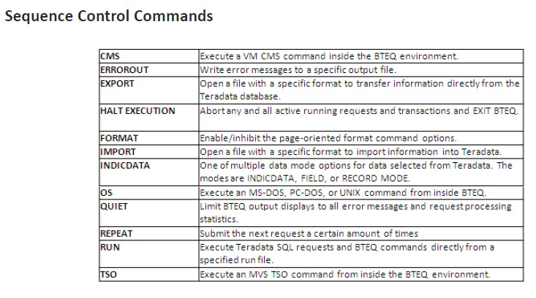
BTEQ Commands

Slide 28
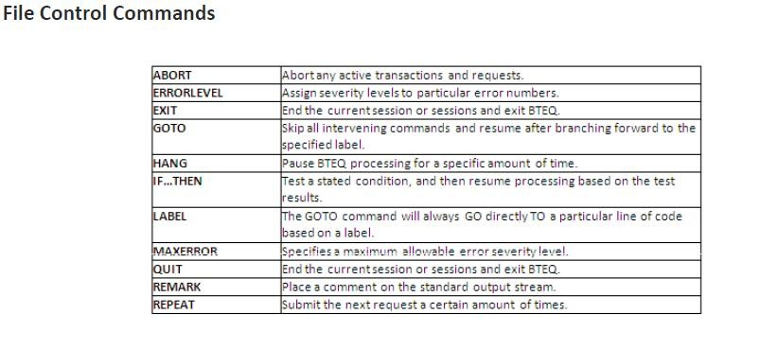
BTEQ Commands

Slide 29
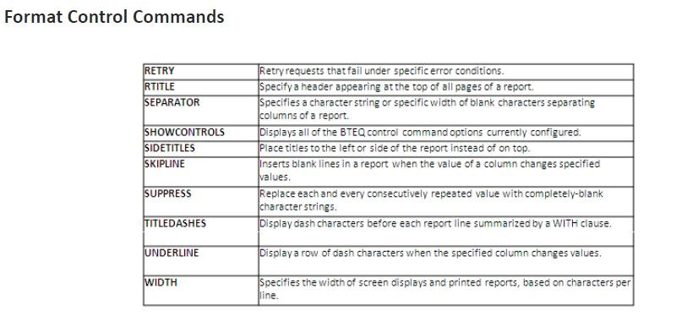
BTEQ Commands

Slide 30
QUIZ
Which application interface is used by BTEQ?
A. ODBC
B. JDBC
C. CLIv2
D. OLE DB
Which two functionalities are available through the BTEQ tool? (Choose two.)
A. supports ad hoc queries
B. is checkpointrestartable
C. runs scripted batch queries
D. provides high volume data export

Slide 31
BTEQ: LAB Exercise
Problem BTEQ_1 :
In this lab, you will use BTEQ to perform imports with different numbers of sessions. You will move selected rows from a data file to the OLAP_EXAMPLE_CLASS table using different sessions.
What you need
OLAP_EXAMPLE_CLASS table and a data file.

Slide 32
BTEQ: LAB Exercise
Tasks
1. Export all the rows to a data file (data2_1) from OLAP_EXAMPLE_CLASS table.
2. Delete all rows from your OLAP_EXAMPLE_CLASS table.
3. Import the rows from your data set (data2_1) to the empty OLAP_EXAMPLE_CLASS table. Note the time and verify the number of rows.
Time: Number of rows:
4. Delete all the rows from your “userid.OLAP_EXAMPLE_CLASS_DMY” table again. (Continue with
the next slide…)

Slide 33
BTEQ: LAB Exercise
5. Specify 8 sessions and import the rows from your data set to the OLAP_EXAMPLE_CLASS table. Note the time and verify the number of rows.
Time: Number of rows:
6. Delete all the rows from OLAP_EXAMPLE_CLASS table again.
7. Specify 50 sessions and import the rows from your data set to OLAP_EXAMPLE_CLASS table. Note the timing and verify the number of rows.
8. What are your conclusions based on the tasks you have just performed?

